Slide 1
SETUP A WORKING DNS SERVER USING BIND9 ON UBUNTU 20.04.LTS DESKTOP EDITION.
Setup a mail server using postfix mta and squirrelmail for the webmail

Slide 2

Steps to achieve this
explaining the importance of a DNS (Domain Name System) server, which translates human-readable domain names into IP addresses that computers use to identify each other on the network.
Installation of BIND9

Slide 3
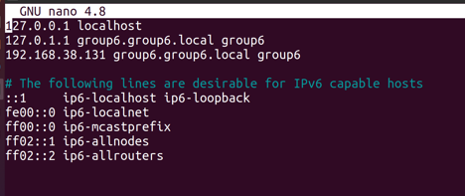
Steps to achieve this
3. Added IP address and domain name to the ubuntu host files.

Slide 4
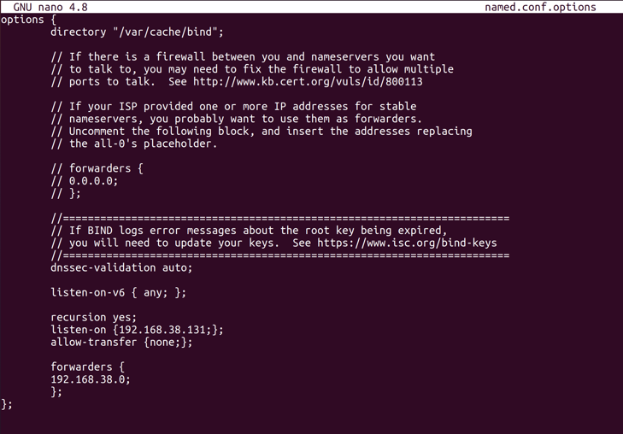
Steps to achieve this
4. Configure the /etc/bind/name.conf.options file.
It holds the main configuration details of the DNS server

Slide 5
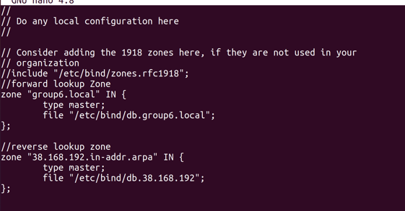
Steps to achieve this
5. Configure the /etc/bind/name.conf.local file
This holds the zone details for the forward and reverse look up zone locally.

Slide 6
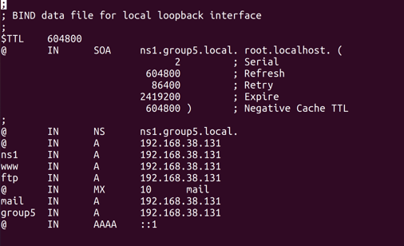
Steps to achieve this
6. Configure /etc/bind/db.group6.local (changed from db.127)

Slide 7
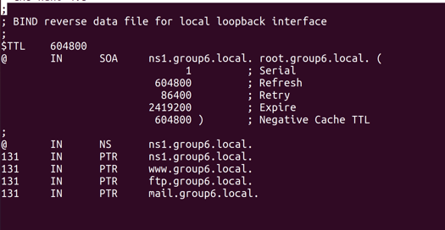
Steps to achieve this
7. Configure /etc/bind/db.38.168.192(reverse lookup file and also modify SOA record)

Slide 8
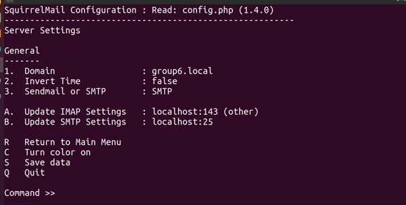
Steps to achieve this
8.Downloaded and installed postfix and dovecot
9. Installed apache and configure domain name for squirrel mail.

Slide 9
Steps to achieve this
Create user accounts for every user in the group.
The authentication details of the squirrel mail is the user name and the user password.
The password of group6 and ubuntu
Kunle:test
Pelumi:test

